Slide 1
Hot Pursuit
Python with Robots Mission 7
Lesson 2 Objectives 4-7

Slide 2

Pre-Mission Warm-Up
In your Mission 7 Lesson 2 log, answer the pre-mission warm-up question:
How is the proximity sensor similar to the line sensor?

Slide 3
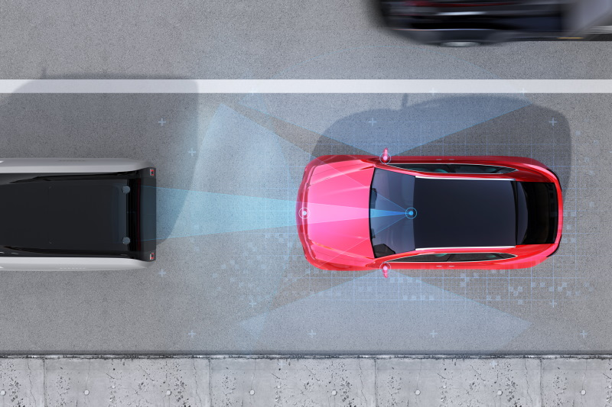
Mission 7: Hot Pursuit
In this project you will:
Go in-depth with the proximity sensors.
Write code to detect, pursue and avoid objects.
These sensors add an awesome new dimension to CodeBot’s capabilities!

Slide 4
Mission 7: Hot Pursuit
Project Goals:
Use the basic proximity sensors detect() function to make a presence detector.
Experiment with light and dark ground-surfaces to find the best emitter power and detection threshold levels for each environment.
Use the range() function to make an interactive display of object reflectivity.

Slide 5

Mission 7: Hot Pursuit
Project Goals:
Write calibration functions so CodeBot can adapt to its environment.
Bring in the motors for a FaceOff challenge.
Code a “Curious Puppy Bot” that will chase a ball around.

Slide 6
Mission 7: Hot Pursuit
For this lesson, we will work on the fourth goal:
Write calibration functions so CodeBot can adapt to its environment.

Slide 7
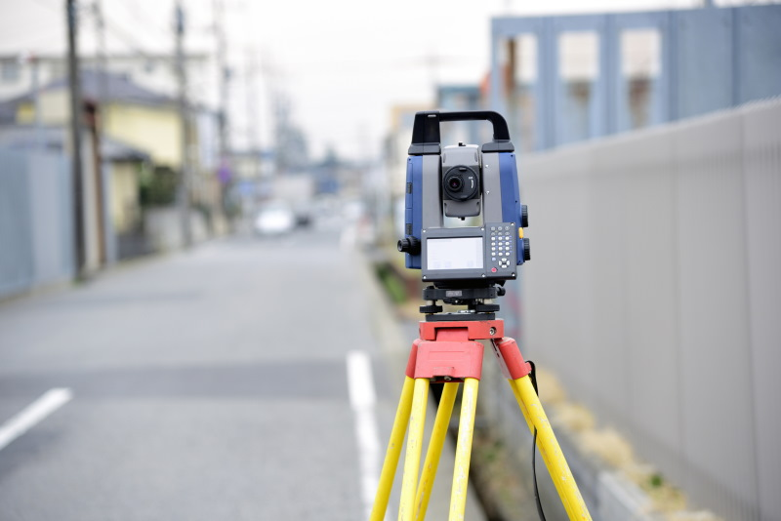
Objective #4: Auto Calibration - part 1
You may have noticed some similarities between the line sensors and the proximity sensors.
Both are based on reflected infrared light.
And both require the ‘bot to adapt to its environment.

Slide 8
Objective #4: Auto Calibration - part 1
Surfaces with different ground reflection require different values for power and thresh.
You saw this in Lesson 1 when you experimented with different combinations of power and thresh.
The function prox.range() helped find the best threshold for a given power.

Slide 9
Objective #4: Auto Calibration - part 1
Auto Calibration
You may have auto-calibrated the line sensors in Mission 6.
When you calibrate a sensor, you adapt it to the environment by determining the best settings.
Using code, you can have CodeBot calibrate its proximity sensors automatically when a button is pressed.

Slide 10
Objective #4: Auto Calibration - part 1
Auto Calibration
Here is how it should work:
Position the ‘bot in a new environment.
Don’t have any objects in front of it.
When BTN-1 is pressed, the proximity sensors scan to automatically find the best power and thresh.
The settings are saved until BTN-1 is pressed again.

Slide 11

Objective #4: Calibration Algorithm
First we will automate the thresh setting.
Let’s look at the code.
Start with a default value for the detection sensitivity. Use the maximum possible threshold (100).
The power is already set at 1
Scan for the best threshold within that power.

Slide 12

Objective #4: Calibration Algorithm
Check the left sensor to see if something was detected.
We know prox.range() returns a tuple, so check the number for LEFT in the tuple.
If something is detected, that number becomes the new value for det.

Slide 13
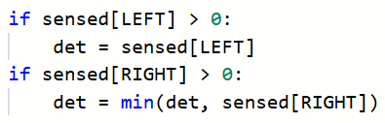
Objective #4: Calibration Algorithm
We also need to check the right sensor to see if something was detected.
If something is detected, we want the lowest number to become the new value for det.
The min() function selects the lowest (or minimum) number.

Slide 14

Objective #4: Calibration Algorithm
We have the detection threshold. But we want it to be just a little bit lower – 5 % less than the maximum (100).
Then print the thresh on the console panel.

Slide 15
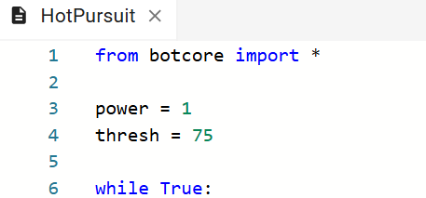
Objective #4 Activity
Let’s put the algorithm into the program.
DO THIS:
Open your program – HotPursuit

Slide 16
Objective #4 Activity
DO THIS:
Start by checking for a button press (if statement). You want to calibrate the ‘bot whenever BTN-1 is pressed.
Include all the code for the algorithm as a block under the if statement.
The last two lines are not part of the block. Be careful with your indenting.

Slide 17
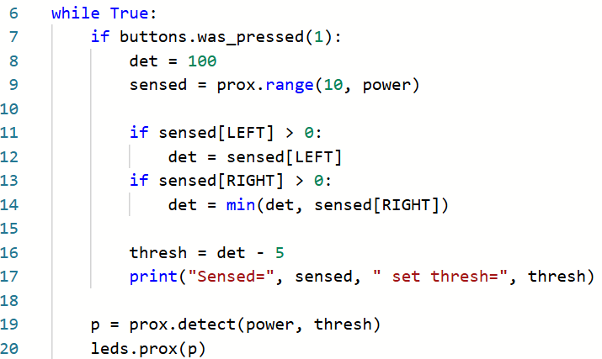
Objective #4 Activity code

Slide 18
Objective #4 Activity
DO THIS:
Place CodeBot on any surface surface.
Run the code.
The proximity sensors are using the initial values of power and thresh.
Open the console panel.
Press BTN-1.
Look at the console panel to see the new thresh.

Slide 19
Objective #4 Activity
DO THIS:
You don’t have to stop the code to try another surface.
Just place CodeBot on another surface and press BTN-1. See the new thresh value in the console panel.
Try at least three different surfaces and record the results in the mission log.

Slide 20
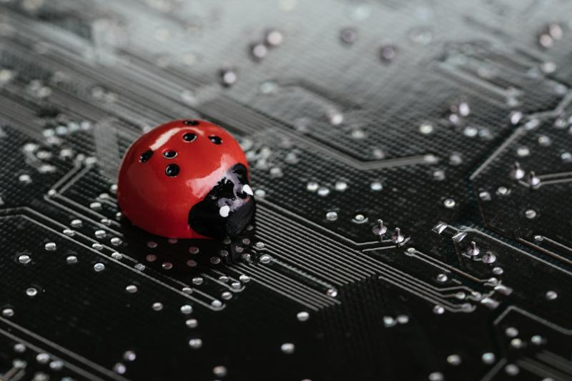
Objective #5: Auto Calibration - part 2
You might notice an error.
Did you try pointing CodeBot in the air, with no surface?
The prox.range() function returns (-1, -1).
So thresh should be 100, not 95.
We can fix this bug with an if statement!

Slide 21
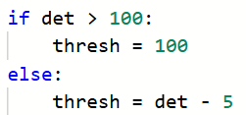
Objective #5: Calibration Algorithm
First change the initial value of det to something higher than 100.
Add an if statement.
If no object was detected, det didn’t change, so set it to the maximum value of 100.
Otherwise, decrease det by 5.

Slide 22
Objective #5 Activity
DO THIS:
Modify your program to include the “bug” fix.
Point CodeBot in the air so there is no surface.
Open the console panel and run the code.
Press BTN-1.
Record the results in your mission log.

Slide 23
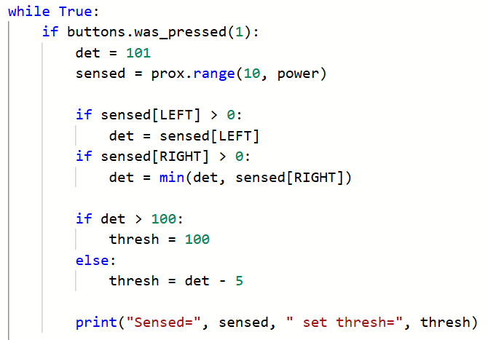
Objective #5 Activity Code

Slide 24

Mission quiz
Now …. time for a quiz!
Answer the three quiz questions in CodeSpace.
CODEX
QUIZ

Slide 25

Objective #6: House Cleaning
Time for some chores!
Most of the code from the last two objectives is crying to be made into a function. (Can you hear it?)
Sometimes being a great programmer requires you to slow down and improve your code.

Slide 26
Objective #6: House Cleaning
Time for some chores!
Take some time to organize by moving your threshold calibration code to its own function.
You will define a new function for this, that assigns a value to the global variable thresh.

Slide 27
Concept: Locals and Globals
Variables defined (created) outside a function are global.
They exist the whole time a program is running.
They can be used and accessed anywhere.
That’s global scope.

Slide 28
Concept: Locals and Globals
Variables defined (created) inside functions are local.
They only exist while the function is running.
Then they go away.
That’s local scope.
A local variable cannot be used or accessed outside the function.

Slide 29
Concept: Locals and Globals
When a variable is assigned a value in a function, it is local.
But what if you need it to be global?
thresh is a global variable.
Use the global keyword at the beginning of the function.
Example:
Then thresh will remain global instead of becoming a local variable.

Slide 30
Objective #6: House Cleaning
Define a function
Usually functions are defined near the top of a program, just below the variables and constants.
Define the function cal_thresh().
Add the global statement as the first line of the function.
Then cut the code for the function from the if statement button press and paste it in the function.
Call the function from the button press if statement.
Add a print statement in the main program to display the power and threshold values.

Slide 31
Objective #6 Activity
DO THIS:
Define a function for cal_thresh().
Add the global command.
Cut the code for the function from the main program and paste it in the function.
Call the function in the if statement.
Add a print statement to display the power and threshold values.

Slide 32
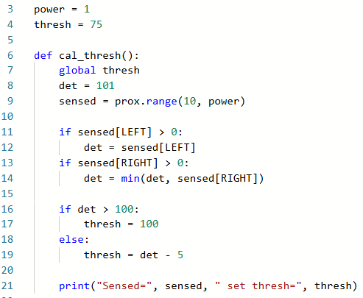
Objective #6 Activity Code

Slide 33
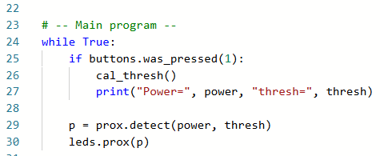
Objective #6 Activity Code

Slide 34
Objective #6 Activity
DO THIS:
Place CodeBot on any surface surface.
Run the code.
Open the console panel.
Press BTN-1.
Look at the console panel to see power and thresh.
The code should work the same as Objective 5, but now it uses a function!

Slide 35

Objective #7: POWER
Now you are ready for power!
Your code calibrates the detection sensitivity threshold.
Next it needs to calibrate the best power level.
Use a loop to cycle through each power level.
Stop the loop when either LEFT or RIGHT sensors detect a reflection.

Slide 36

Objective #7: Calibration Algorithm
Add another function cal_power()
This function will call cal_thresh().
It will assign a value to power, so use the global command.
Start the power with the value 1.

Slide 37
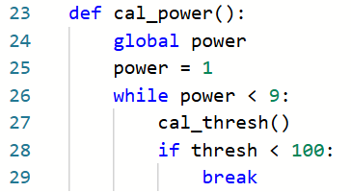
Objective #7: Calibration Algorithm
Now loop through the power levels, and call cal_thresh() for each power level.
Break out of the loop when either LEFT or RIGHT detects a reflection.

Slide 38
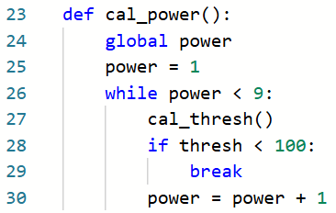
Objective #7: Calibration Algorithm
Don’t forget to increment power inside the loop (but not inside the if statement)!

Slide 39
Objective #7 Activity
DO THIS:
Define a function for cal_power().
Add the global command.
Add the loop for scanning the power levels.
Increment power.

Slide 40
Objective #7 Activity Code

Slide 41
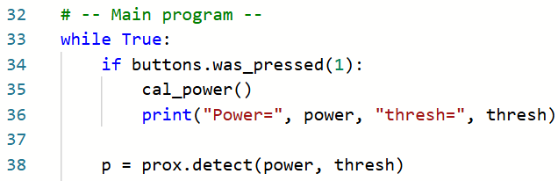
Objective #7 Activity
DO THIS:
Call the call_power() function in the main program, instead of cal_thresh().

Slide 42
Objective #7 Activity
DO THIS:
Open the console panel and run the code.
Press BTN-1.
Try at least three different surfaces, pressing BTN-1 each time.
Record the results in the mission log.

Slide 43

Extension
If the ‘bot is pointed up, with no surface, the code will throw a runtime error in the cal_power() function. Fix the error. You can use in if statement, similar to the “bug” fix for the threshold.

Slide 44
Post-Mission Reflection
Complete the post-mission reflection in your Mission 7 Lesson 2 Log:
What is something you learned about proximity sensors during this lesson?
What is something you learned about functions during this lesson?

